Slide 1
A
Project Seminar
on
“Clustering of Big Data Using Data Mining”

Slide 2
Contents
Introduction
Literature Survey
Objectives
Workflow
Implemented Modules
Conclusion
References

Slide 3
Introduction
Big data concern large-volume, complex, growing data sets with multiple, autonomous sources with the fast development of networking, data storage, and the data collection capacity.
Big data are now rapidly expanding in all science and engineering domains including physical,biological and biomedical sciences.
Data-driven model involves demand-driven aggregation of information sources mining, analysis, user interest modelling, security and privacy.

Slide 4
Literature Survey
Sr.no | Title | Year | Issues | Methodology
1. | Data mining with using clustering and classification algorithms R.Ahmed & Karypis | 2011 | Cluster validity index Density of objects | K-meloids K-means
2. | Mining High-Speed Data Streams Pedro Domingos. PhD thesis, Basser Department Of Computer Science. | 2011 | Many organizations have more than number of data-bases that grow without limit at a rate of several million records per day | ERP CRM
3. | Clouds, Big Data, and Smart Assets: Ten Tech-Enabled Business Trends Jacques Bughin, Michael Chui, and James Manyik | 2013 | Social technologies are becoming a powerful social matrix organizational infrastructure that links and engages employees, customers, and suppliers | The integration of digital and physical experiences is creating new ways for business

Slide 5
Cont..
Sr.no | Title | Year | Issues | Methodology
4. | Verification and validation of MapReduce program model for Hadoop cluster R.Chen K. Sivakumar, and H.Kargupta | 2013 | Large volume of data is growing Increasing computation requirements,data variety,complexity | ETL,ELT approach EDW
5. | The role of apriori alg for finding the association rules in data mining David Brownstone | 2013 | Find all item-sets with adequate supports | Generate association rules for frequent/large item-sets
6. | FPGA implementation for informatics application 5th IEEE International Conference on Awareness Science and Technology, Aizu-Wakamatsu, Japan, pp. | 2013 | Data selection Data preparation Data exploration Pattern discovery | Microarray technique

Slide 6
Sr.no | Title | Year | Issues | Methodology
7 | Big data: testing approach to overcome quality challenges ,Machanavijjhala &J.P.Reiter | 2013 | Data quality Data sampling Automation | Validate data quality by employing a structured testing technique
8 | A survey on clustering data mining Techniques, F.casati,E.Shan,u.Dayal,and M.Shan | 2014 | Computation Selection Clustering Analysis | Datasets to find relationships ANN,Fuzzy sets-theory Approximate reasoning
9 | Data Mining with Big Data Xindong Wu, Fellow, IEEE, Xingquan Zhu et. al. | 2014 | Big Data revolution, and proposes a Big Data processing model from the data mining perspective | HACE theorem that characterizes the features
10 | Analyzing Collective Behavior from Blogs Using Swarm Intelligence, Knowledge and Information Systems. G.Alonso,F.Casati,h.kuno,and V.Machiraju | 2014 | The ability of commonly used software tools to capture,manage and process the data within a tolerable time | Dynamic correlation technique

Slide 7
An Algorithm Bisecting K-Means
Input : K : No of clusters
D : Top N documents obtained by vector space similarity
Output : K clusters
Put all the N documents in a single cluster c
for i=1 to K-1 do
for j=1 to ITER do
Use K-Means to split C into two sub-clusters C1 & C2
If ( intra-cluster similarity (C1))
( intra-cluster similarity (C2))
Make cluster C1 as permanent
C=C2
Else
Make cluster C2 as permanent
C=C1
End if
End for
End for

Slide 8
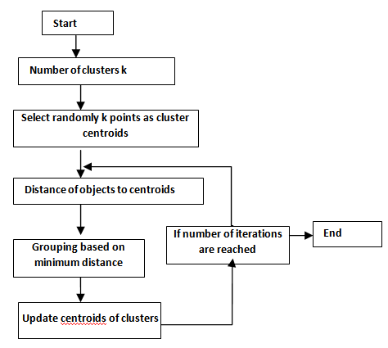
Workflow

Slide 9
MapReduce
A simple programming model
Functional model
For large-scale data processing
  Exploits large set of commodity computers
  Executes process in distributed manner
  Offers high availability

Slide 10
MapReduce Model
R
E
D
U
C
E
Very
big
data
M
A
P
Partitioning
Function
Result

Slide 11
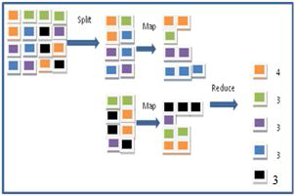
Cont..

Slide 12
Objectives
A partition of a real data set generated by a clustering algorithm.
To identify the genuine clusters from the partition.

Slide 13
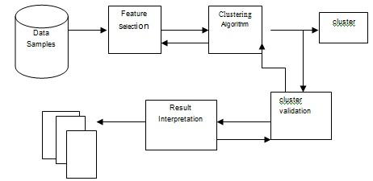
Workflow

Slide 14
Conclusion
MapReduce proven to be useful abstraction
Greatly simplifies large-scale computations
Partition of a real data set generated by a clustering algorithm.
The genuine clusters are identified from the partition.

Slide 15
References
[1] BABU, G.P. and MARTY, M.N. 1994. Clustering with evolution strategies Pattern Recognition, 27, 2, 321-329.
[2] Fayyad, U. Data Mining and Knowledge Discovery: Making Sense Out of IEEE Expert, v. 11, no. 5, pp. 20-25, October 1996.
[3] Guo, G, Neagu, D. (2005) Similarity-based Classifier Combination for Decision Making . Proc. Of IEEE International Conference on Systems, Man and Cybernetics, pp. 176-181
[4] Jyothi Bellary, Bhargavi Peyakunta, Sekhar Konetigari “Hybrid Machine Learning Approach In Data Mining”, 2010 Second International Conference on Machine Learning and computing.
[5] Oyelade, O. J, Oladipupo, O. O, Obagbuwa, I. C” Application of k- means Clustering algorithm for prediction of Students Academic Performance” (IJCSIS) International Journal of Computer Science and Information Security, Vol. 7, 2010.
[6]Varun Kumar and Nisha Rathee, ITM University, “Knowledge discovery from database Using an integration of clustering and classification”, International Journal of Advanced Computer Science and Applications, Vol. 2, No.3, March 2011.
[7] McKinsey Global Institute (2011) Big Data: The next frontier for
innovation, competition and productivity.
[8] Chen, H., Chaing, R.H.L. and Storey, V.C. (2012) Business Intelligence and Analytics: From Big Data to Big Impact, MIS Quarterly, 36, 4, pp. 1165-1188.
[9] Patel, A.B., Birla, M. and Nair, U. (2012) Addressing Big Data Problem Using Hadoop and Map Reduce, NIRMA University Conference on Engineering, pp. 1-5.

Slide 16
Cont..
[10] Wu Yuntian, Shaanxi University of Science and Technology, “Based on
Machine Learning of Data Mining to Further Explore”, 2012 International
Conference on Machine Learning Banff, Canada.
[11]Neelamadhab Padhy, Dr. Pragnyaban Mishra and Rasmita Panigrahi, “The Survey of Data Mining Applications And Feature Scope”, International Journal of Computer Science and Information Processing(CSIP).
[12]Aditya B. Patel, Manashvi Birla, Ushma Nair, (6-8 Dec. 2012),”Addressing Big Data Problem Using Hadoop and Map Reduce”.
[13]Shiv Pratap Singh Kushwah, Keshav Rawat, Pradeep Gupta” Analysis and Comparison of Efficient Techniques of Clustering Algorithms in Data Mining” International Journal of Innovative Technology and Exploring Enginneering (IIJITEE) ISSN: 2278-3075, Volume-1, Issue-3, August 2012.
[14]Tekiner F. and Keane J.A., Systems, Man and Cybernetics (SMC
), “Big Data Framework” 2013 IEEE International Conference on 13-16 Oct. 2013, 1494-1499.
[15]Dong, X.L.; Srivastava, D. Data Engineering (ICDE),’ Big data integration” IEEE International Conference on , 29(2013)1245-1248.
[16]Sagiroglu, S.; Sinanc, D.,”Big Data: A Review”,2013,20-24.

Slide 17
Cont..
[17]Kyuseok Shim, MapReduce A lgorithms for Big Data Analysis, DNIS 2013, LNCS 7813, pp. 44-48, 2013.
[18]Madhuri V. Joseph, Lipsa Sadath and Vanaja Rajan” Data Mining: A Comparative Study on various Techniques and Methods” International Journal of Advanced Research in Computer Science and Software Engineering Volume 3, Issue 2, February 2013 ISSN: 2277.
[19]Aastha Joshi, Rajneet Kaur” A Review: Comparative Study of Various Clustering Techniques in Data Mining” International Journal of Advanced Research in computer Science and Software Engineering, Volume 3, Issue 3, March 2013.
[20]Yaxiong Zhao; Jie Wu INFOCOM, “Dache: A Data Aware Caching for Big-Data Applications Using the MapReduce Framework” 2014 Proceedings IEEE 2014, 35 – 39 (Volume 19).
[21]Wu, X., Zhu, X., Wu, G., Ding, W. (2014) Data Mining with Big Data, Knowledge and Data Enginnering , IEEE Transactions.

Slide 18
Thank You

